Slide 1

Hide and Seek
Crystal Monica Abou Jneid – Mia Antoun – Edwin Odeimi
Dr. Joe Tekli

Slide 2
Introduction
The Hide and Seek game will be used to compensate the lack of independency of children who spend most of their time at home and do not play outside with children of their age.
The product we will be developing, which is the android mobile application, could be considered as an independent entity that is not related to a bigger system.
The android application will be specifically designed to be used by those children. It will provide them with capabilities to conquer their fear of autonomy and separation, providing them with joy in reunification and helping them practice and gain independence.

Slide 3
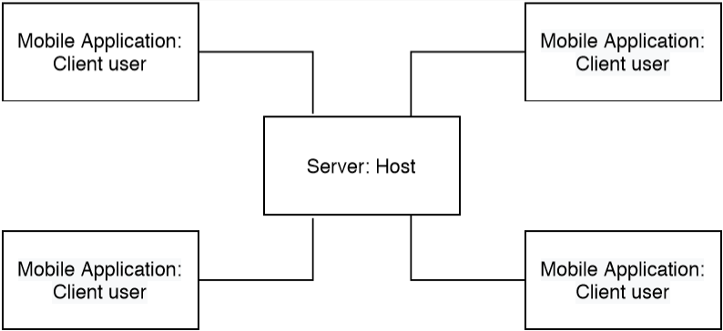
Context Model

Slide 4
Game path

Slide 5
Game path
First, the users must login
Then the users enter the first round
When first round ends, the second round begins
When the second round ends, the game is terminated

Slide 6
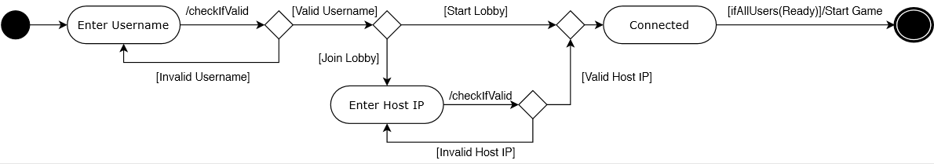
Login
Users must login first in order to enter the game:

Slide 7
Login
Condition | Action
Username contains less than three characters | ERROR: Check your input!
Username contains empty space characters | ERROR: Check your input!
Username does not start with a letter | ERROR: Check your input!
Any of the remaining letters is not a number, an underscore character or a letter | ERROR: Check your input!
The username must follow certain rules.
Any of these conditions that is not met will generate an error message.

Slide 8
Login
Condition | Action
Textbox contains characters that are not digits | ERROR: Invalid IP address.
Textbox does not correspond to the rightmost three digits of the host | ERROR: There was a networking error!
The textbox must follow certain rules.
Any of these conditions that is not met will generate an error message.

Slide 9
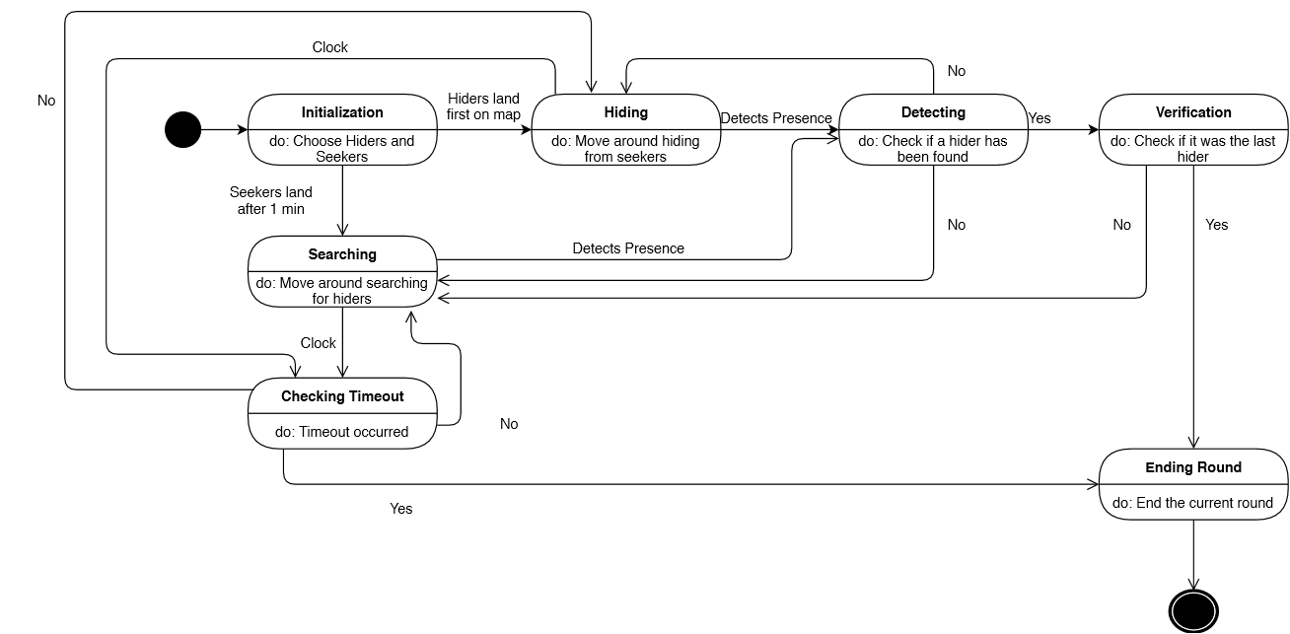
Game description
The first round starts, it works as follows:

Slide 10
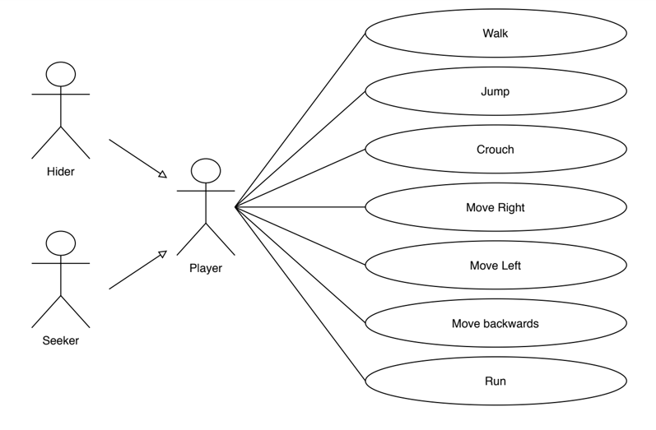
Entering the game
When the game starts, the clients and the host become players.
They are randomly divided into hiders and seekers.

Slide 11
Game description
Additional notes:
The map contains a circle zone such that the center of this circle is chosen randomly.
This circle shrinks every other second in size.
When the Hiders are outside the circle, a storm appears to them.
However, this storm does not appear to the Seekers.
Because of this storm, the Hiders easily detectable.
Hiders cannot stay at the same location.

Slide 12
Game description
When the first round ends, the second round begins.
The second round operate in the same way as the first round.

Slide 13
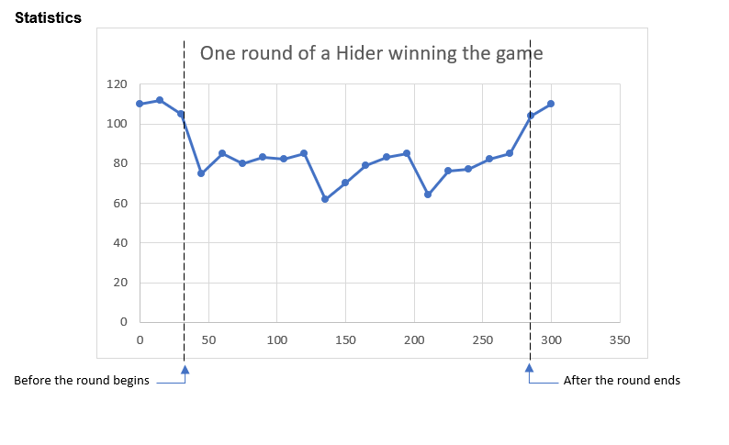
Performance Measures

Slide 14
Non-Functional Requirements
Efficiency
Maintainability
Usability
Size and memory management
Security

Slide 15
Note
The host sends the IP address of the first user that was “Connected” to the game, to all remaining “Connected” users to the game from to the time at which all users were “Connected” until the middle of the game.
In case the host leaves the game early:
The first player that was “Connected” to the game will become the host.
The other users will attempt to connect to the newly designated host.
Each user will be given ten attempts in order to try to establish a connection with the host.
If after ten attempts the user fails to connect to the host, he will be redirected to the second scene, in which he has to choose between the “start lobby” button and the “join lobby” button.

